Slide 1
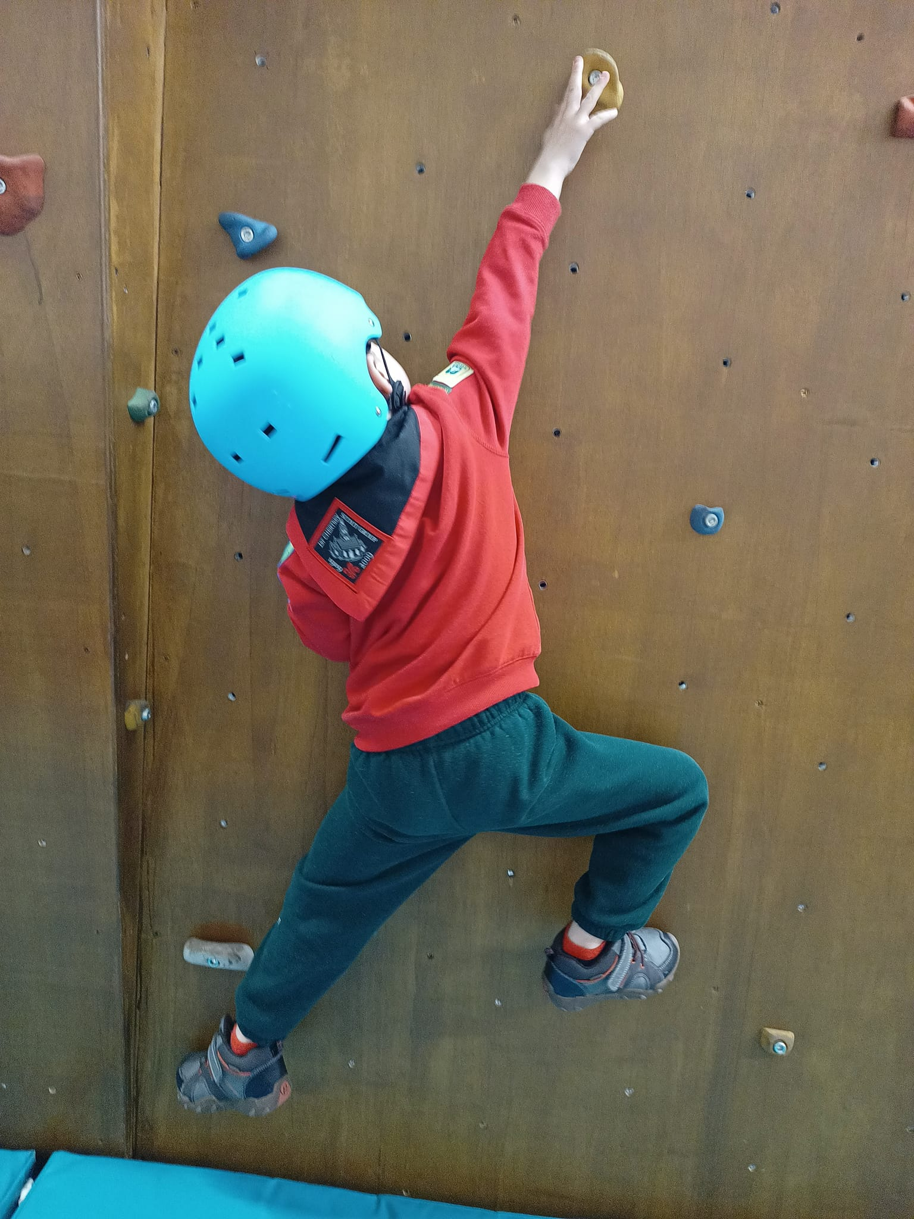
Runnymede
AGM
2023 Report & Accounts

Slide 2
Over 1000 members across Runnymede
 | 2023 | 2022
Squirrels | 16
Beavers | 222 | 240
Cubs | 284 | 284
Scouts | 201 | 208
Explorers | 100 | 76
Inc Young Leaders | (39) | (20)
Adult Leaders | 140 | 140
Officers | 63 | 67
Total | 1026 | 1015

Slide 3
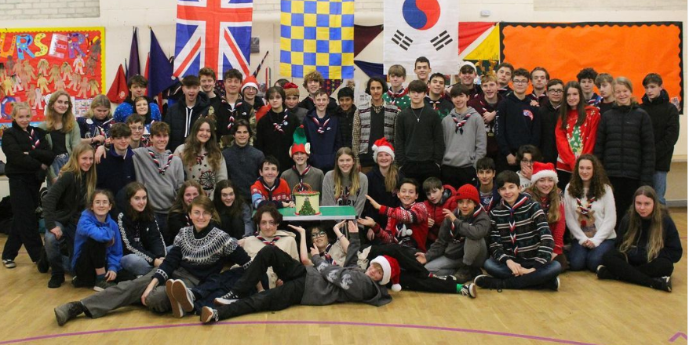
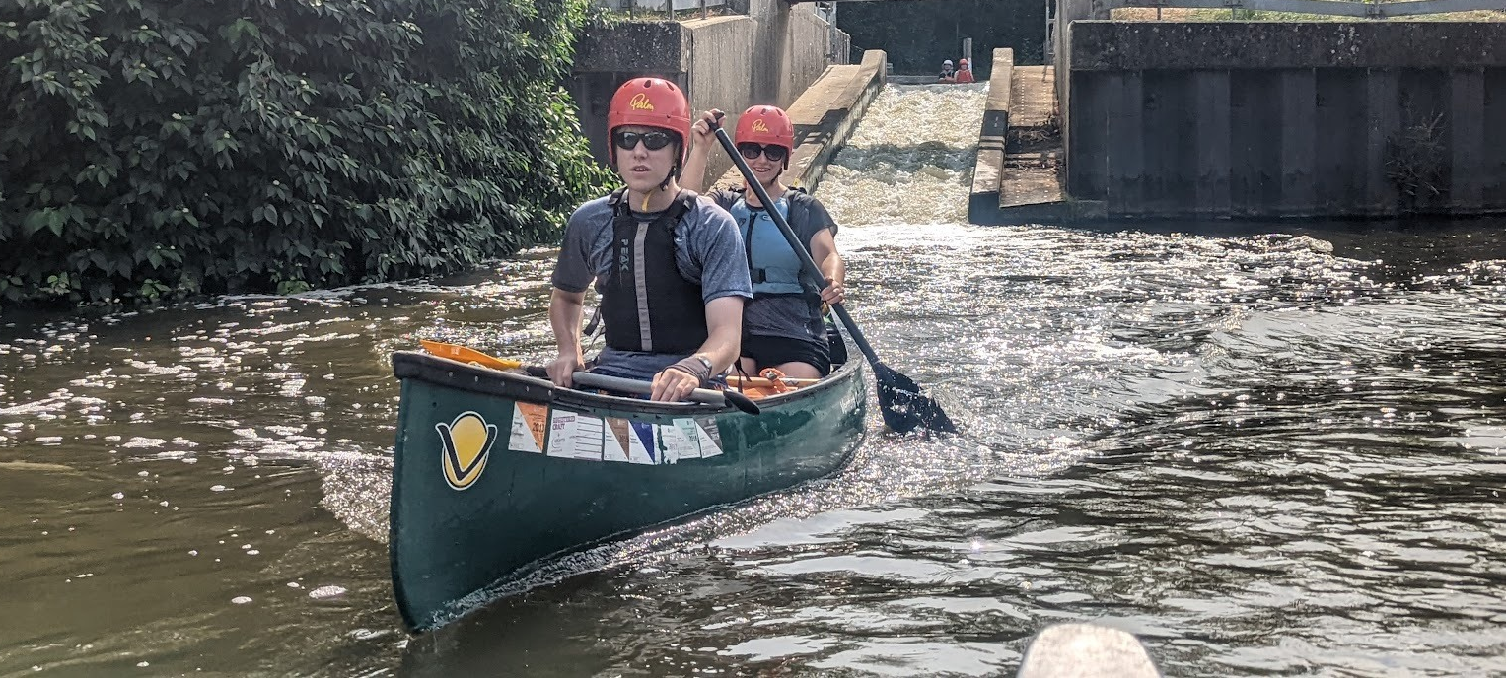
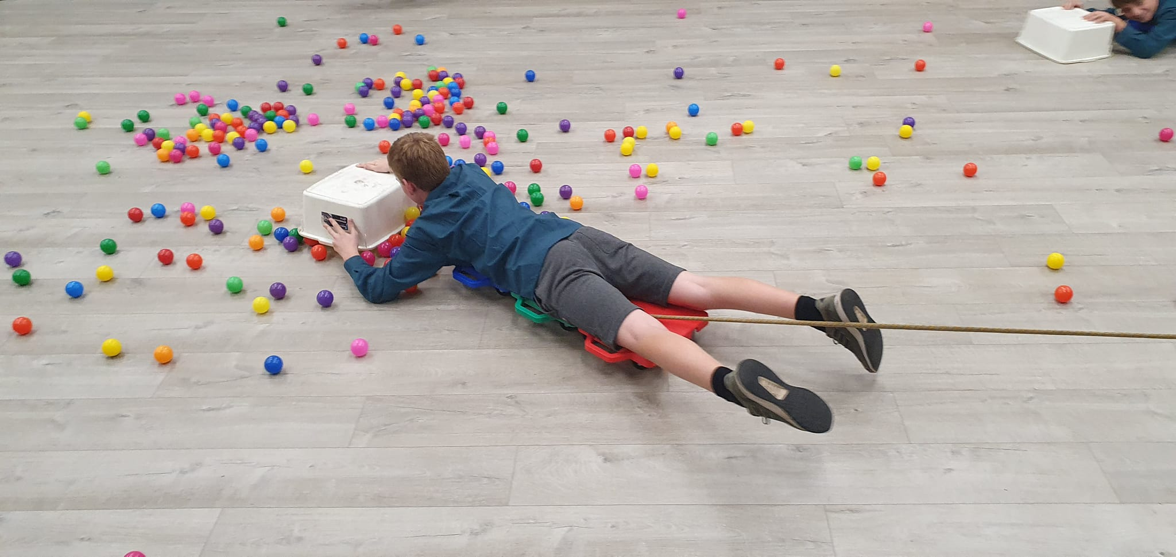
Scouting in Runnymede
Camps and activities back into full swing with highlights including our Explorers visiting our twin town in Germany, Scoutabout for the Scouts and Beavers camping at Birchmere.
New Youth Commissioner appointed
4 Young People attending 2023 Jamboree in Korea in summer 2023
District has funded training so we can offer more archery, kayaking and tomahawk throwing activities

Slide 4
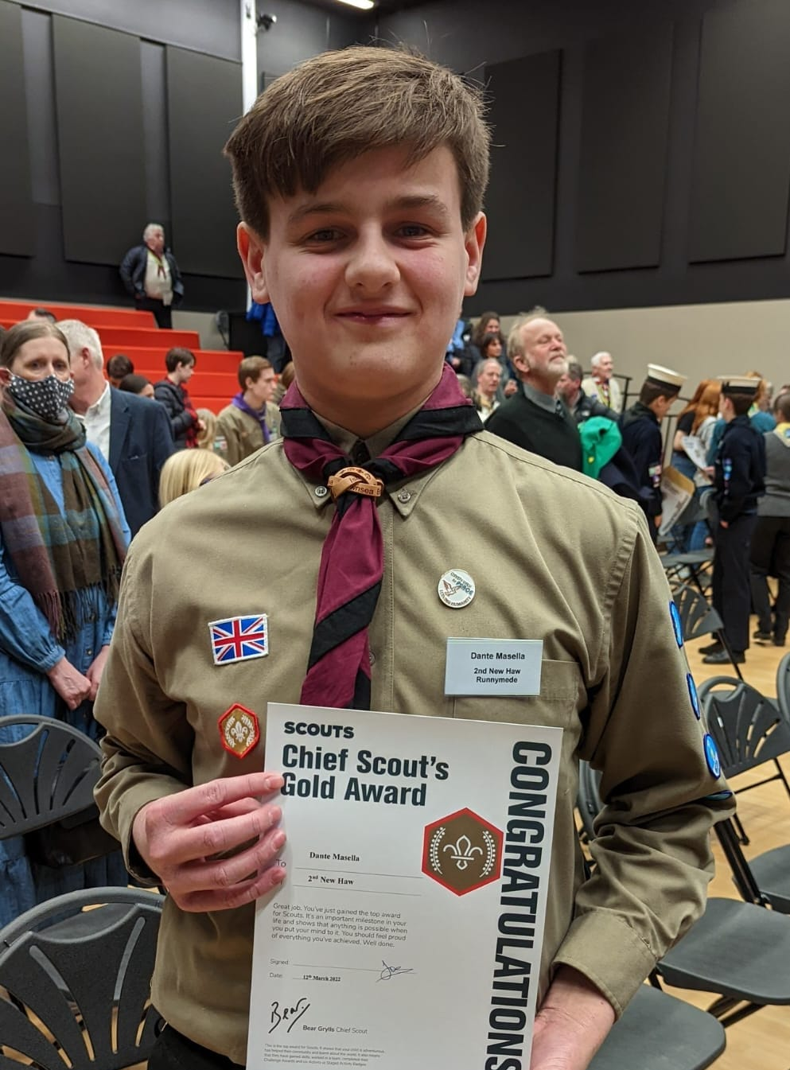
Top Awards
4 (-) Acorn Awards
48 (36) Bronze Chief Scout Awards
36 (31) Silver Chief Scout Awards
23 (8) Gold Chief Scout Awards
1 (-) Platinum Chief Scout Award
2 Explorer Belts
1 Young Leader Award
7 Bronze & 7 Silver DofE Awards

Slide 5
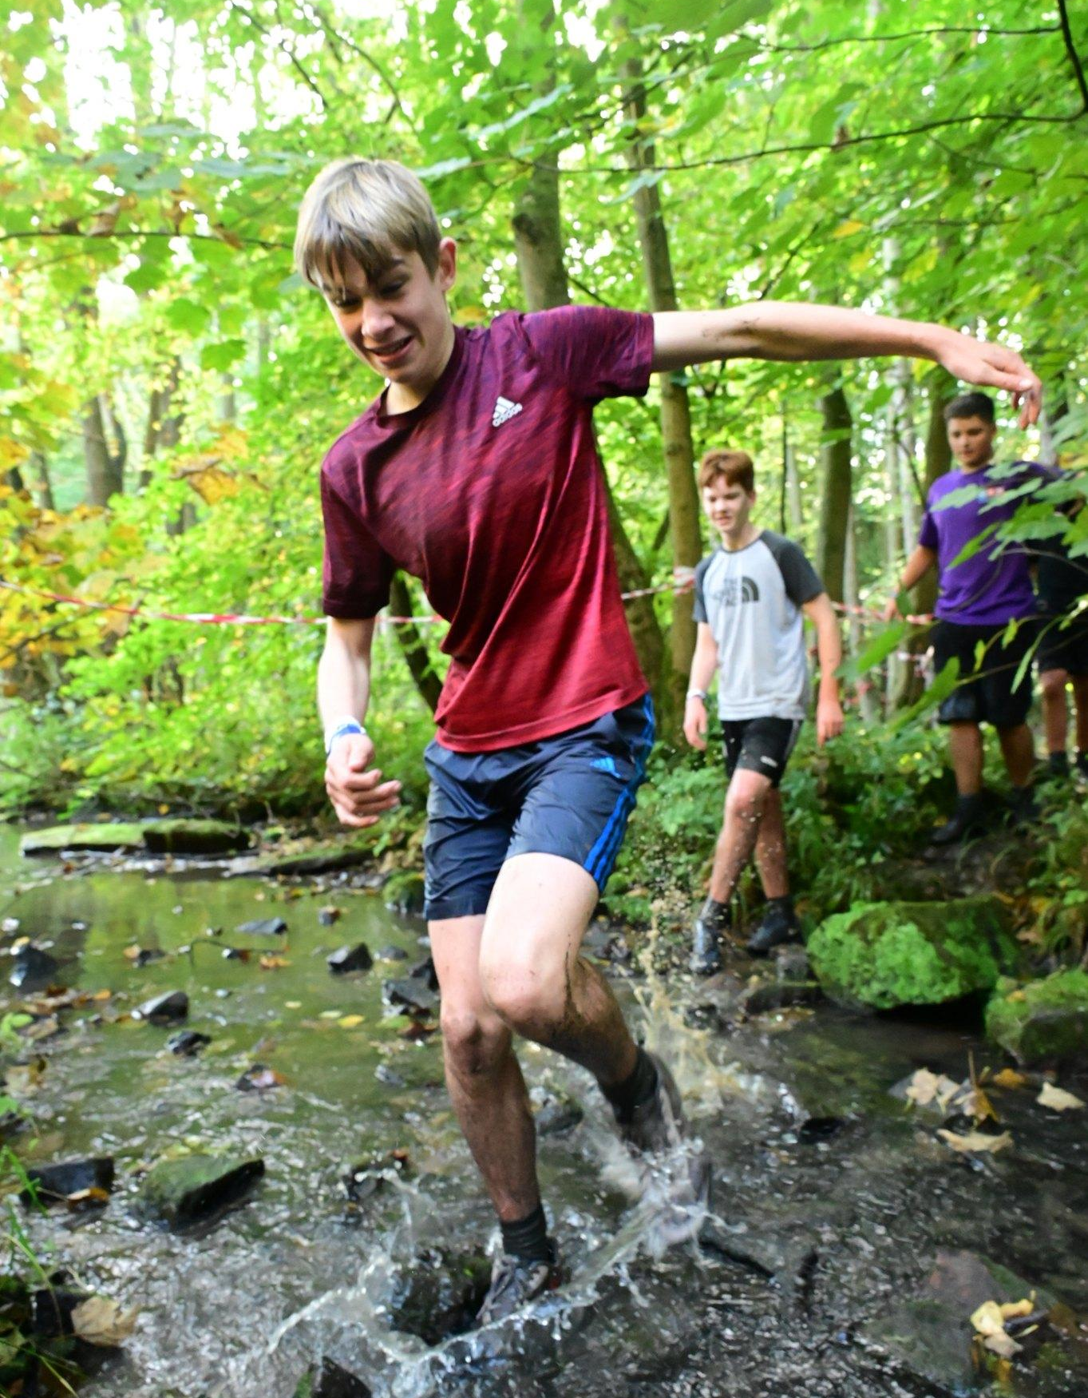
Runnymede Explorer Scouts
7 Silver DofE awards completed with more to come
Two Explorers completed their Explorer Belt in Luxembourg
Young Leaders attended County training with one completing their YL belt
District Camp held at Ferny Croft campsite in the New Forest
Attended Apex Challenge in Yorkshire

Slide 6
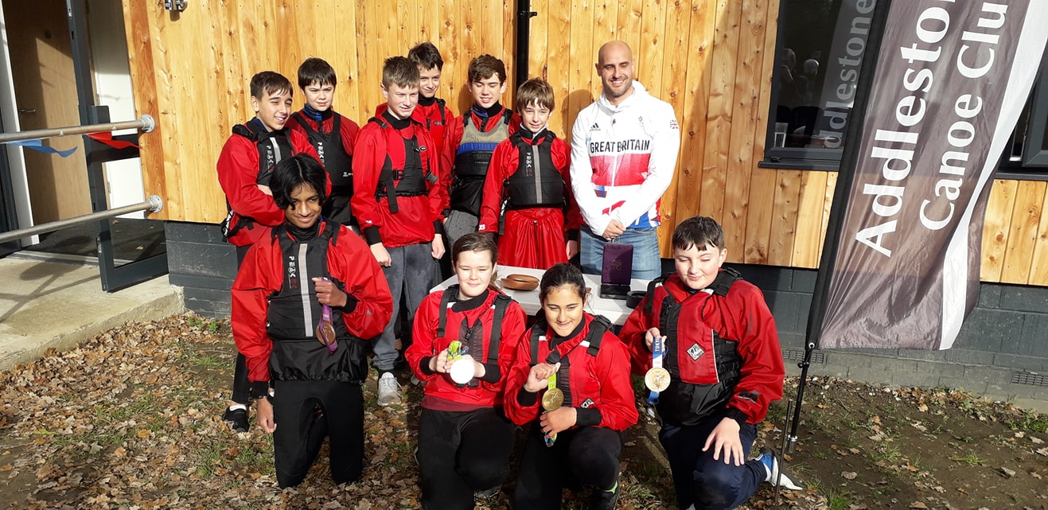
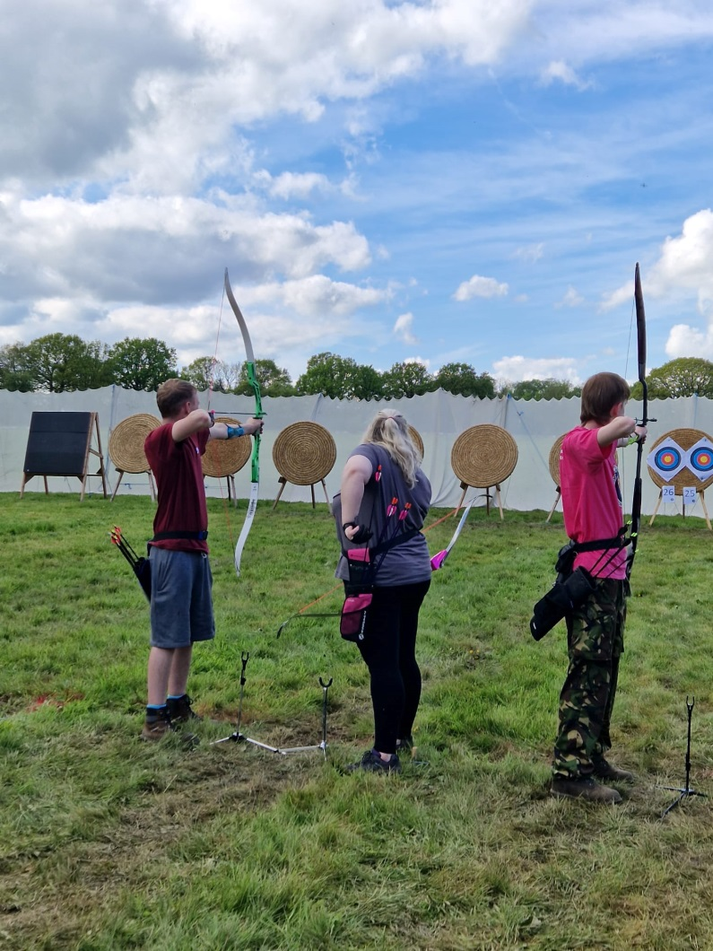
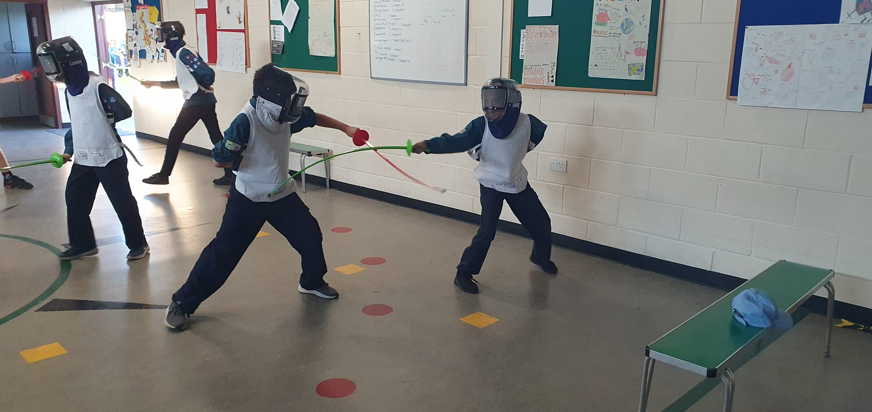
Activity Clubs
Runnymede and Woking Scout Canoe Club ran sessions for 546 Beavers, Cubs, Scouts and Explorers and awarded a number of BCU Explore Awards,
Our Archery Club attended the 16th National Scouts Archery Competition bringing home one gold, two silver and one bronze award
Number of Leaders completed activity training this year

Slide 7
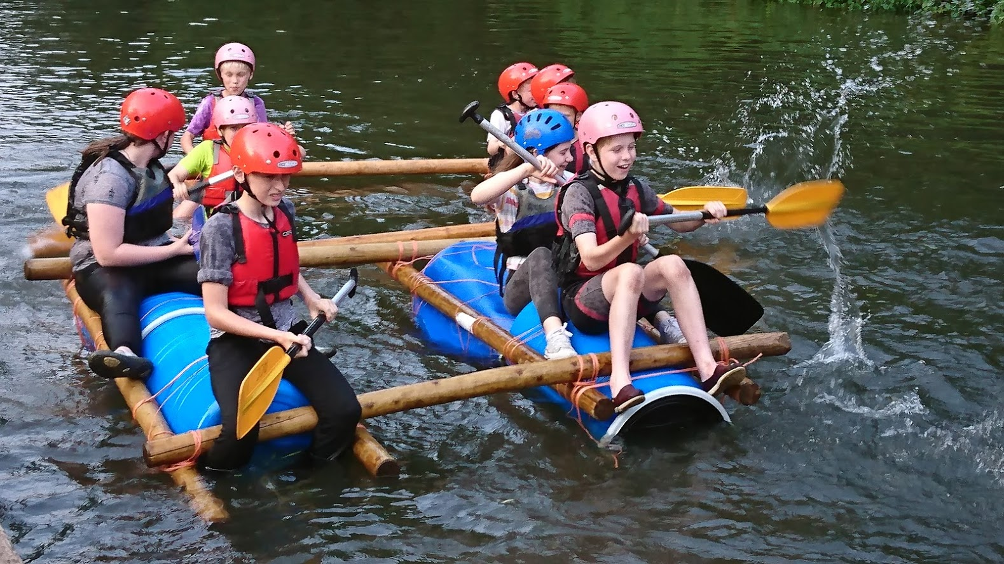
2018-19 Accounts
Runnymede
Accounts
2022-2023

Slide 8
Accounts
2022-23 2021-22
Income £66,676 £35,033
Expenditure £58,990 £32,433
Surplus on year £7,686 £2,590

Slide 9
Balance Sheet
As at 31.03.23 As at 31.03.22
General Fund £38,301 £40,805 Designated funds £37,996 £27,231
Michael Patrick Fund £46,403 £46,978
Total £122,700 £115,014

Slide 10
Designated Funds
As at 31.03.22 As at 31.03.22
Designated funds £37,996 £27,231
Jamboree £16,780 £8,805
Explorers £12,037 £11,557
Network £219 £219
SASU £389 £446
Archery Club £1,339 £845
Water Activities SASU £1,483 £642
Beavers reserve £2,883 £2,233
Cubs reserve £2,551 £2,051
Scouts reserve £- £100
DCs Discretionary £315 £315

Slide 11
Runnymede Borough Council grants
1st Chertsey Tents £394
1st Ottershaw Griddle £296
1st Virginia Water Gazebo £168
District Feather Flags £130
Water Activities Paddleboards £330
District Marquee equipment £182
Total £1,500

Slide 12
Capitation
 | 2023-2024 | 2022-2023 | 2021-22 | 2020-21 | 2019-20
HQ | 36.00 | 35.00 | 36.50 | 29.00 | 28.00
County | 7.75 | 8.75 | 7.25 | 9.25 | 9.25
District | 1.50 | 1.50 | 0 | 7.00 | 7.00
Total | £45.25 | £45.25 | £43.75 | £45.25 | £44.25

Slide 13
Runnymede Scout Shop
Over the 13 years since the online shop was started £10,700 has been returned to
groups in rebates and capitation has been reduced by about 50p per head each
year.
1st Egham Hythe | £123.54 | 1st Ottershaw | £107.42
1st New Haw | £63.94 | 1st Chertsey | £72.30
1st Virginia Water | £12.65 | 2nd New Haw | £87.35
1st 4th Addlestone | £34.80 | 1st Egham | £51.70
2nd Thorpe | £2.70 | 1st Englefield Green | £26.70
5th Addlestone | £8.43

Slide 14
Runnymede

